Slide 1
Bonfire Night & Fireworks
Reinforcement Session

Slide 2
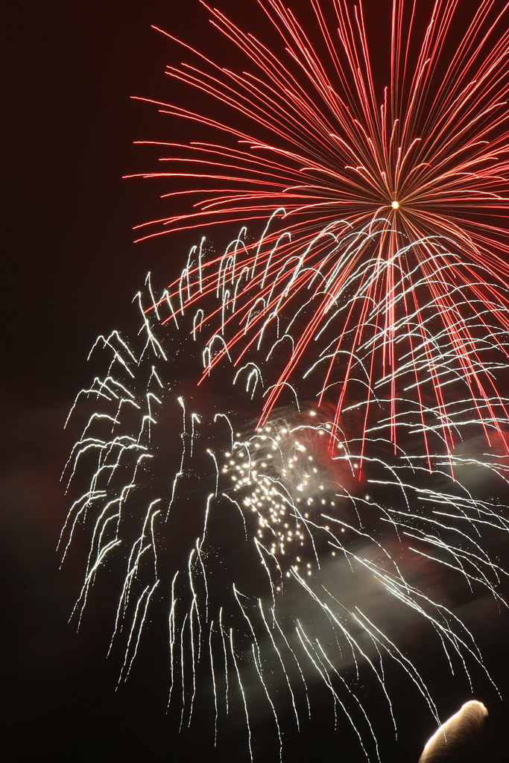
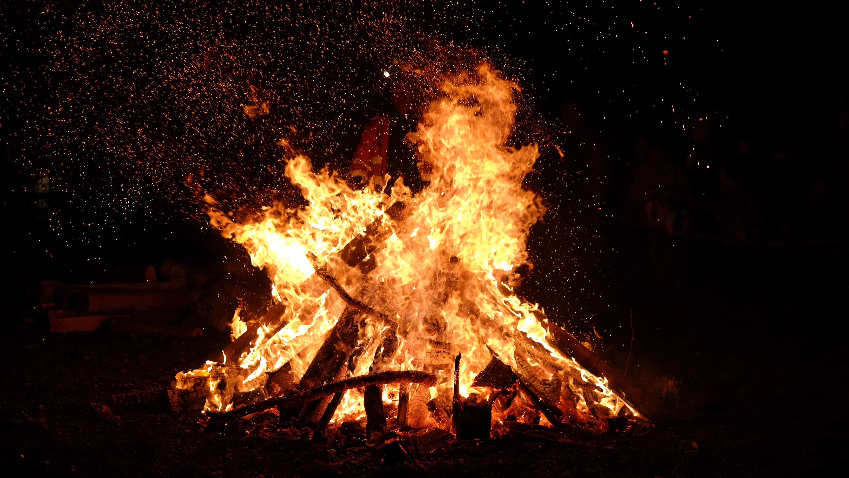
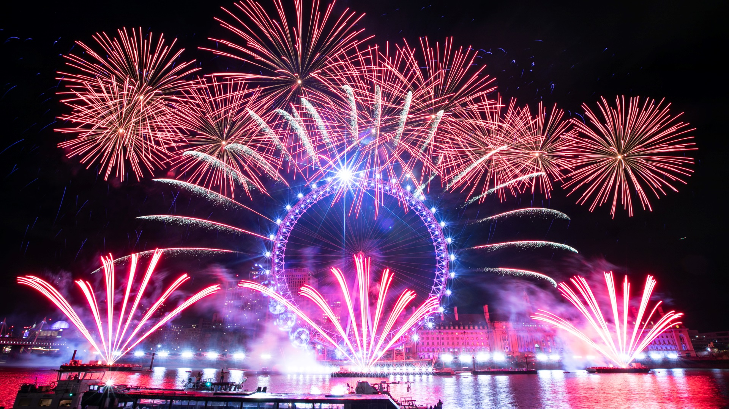
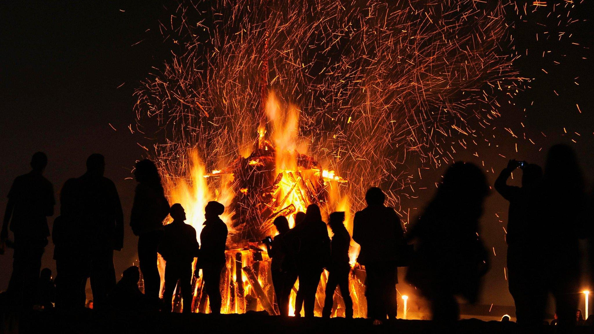
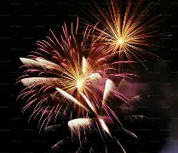
BONFIRE NIGHT…
Most people don't set out to make bad decisions
Problems often happen because of pressure from friends, wanting to fit in or not thinking about the consequences.

Slide 3
REFLECTION…
What's the biggest consequence people your age often don't think about?

Slide 4
BONFIRE NIGHT…
1. You're with friends on Bonfire Night. Someone suggests throwing fireworks at a bus stop for a laugh.
  What could happen?
  Who could be affected?
  What would you do?
2. A friend wants to start a small fire in a local park.
  What's the worst-case outcome?
  Who is impacted by that decision?
  How could you get out of the situation?
3. Your friends are pressuring you to stay, but you know things are getting out of hand.
  Why is it difficult to walk away?
  What could you say?
  What's the smart choice?

Slide 5
FINAL CHALLENGE…
"This Bonfire Night, I'm going to..."

Slide 6
STOP – THINK - CHOOSE
✅ Is it safe?
✅ Is it legal?
✅ Can you guarantee no one will get hurt?
✅ Would I be happy explaining this to my family tomorrow?
✅ Would I be happy explaining this to my friend’s family tomorrow?
If the answer is no to any of these, walk away 🚒🎆
Enjoy the fireworks, not the consequences

Slide 7
THANK YOU FOR LISTENING

