Slide 1
Choices & Consequences
Reinforcement Session

Slide 2
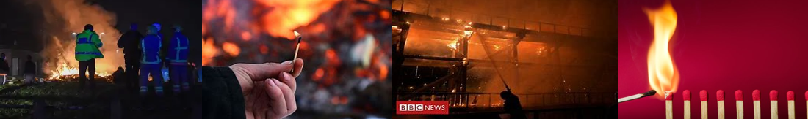
RECAP
What is arson?
Why are deliberate fires dangerous?
In pairs, discuss as many consequences as you can remember in 60 seconds

Slide 3
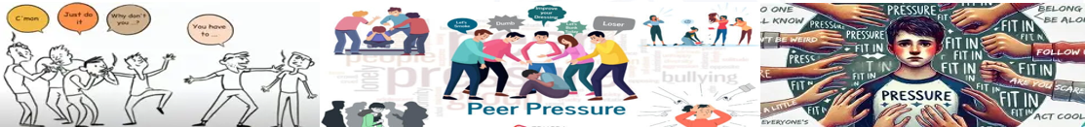

REFLECTION…
What is the best way to deal with peer pressure?

Slide 4
Deliberate Fires
1. You notice smoke coming from a small deliberate fire that some older teenagers have started in a wooded area. They tell you not to report it because "it's under control."
  Would you trust that the fire is under control?
  What should you do next?
  Why is reporting a deliberate fire important, even if it looks small?
2. After school, a group of young people find an old shopping trolley and some rubbish in a local park. Someone suggests setting fire to it for entertainment because "it's already junk anyway.“
  Why is this still a dangerous idea even though the items are unwanted?
  What could happen if the fire spreads to nearby grass, trees or property?
  How might emergency services be affected by attending this incident?
3. Your friends are pressuring you to stay, but you know things are getting out of hand.
  Why is it difficult to walk away?
  What could you say?
  What's the smart choice?

Slide 5
True or False?
Starting a fire as a prank can still be a crime
True
2. If nobody gets hurt, there are no consequences for starting a fire
False
3. Firefighters attending deliberate fires may be delayed from other emergencies
True
4. Deliberate fires only affect the person who starts them
  False
5. Walking away is a positive choice
  True

Slide 6
True or False?
6. A small fire can quickly spread and become dangerous
True
7. Recording a deliberate fire for social media isn’t as bad as starting the fire
False
8. Reporting a deliberate fire is the right thing to do
True
9. Young people cannot be held responsible for deliberate fires
False
10. One good decision can stop a small problem becoming a major incident
True

Slide 7
FINAL THOUGHTS…
What is one thing you will remember from today?
What would you do if someone encouraged unsafe behaviour?

Slide 8
STOP – THINK - CHOOSE
✅ Is it safe?
✅ Is it legal?
✅ Can you guarantee no one will get hurt?
✅ Would I be happy explaining this to my family tomorrow?
✅ Would I be happy explaining this to my friend’s family tomorrow?
If the answer is no to any of these, walk away 🚒🎆
It’s just not worth it!

Slide 9
THANK YOU FOR LISTENING

